Slide 1
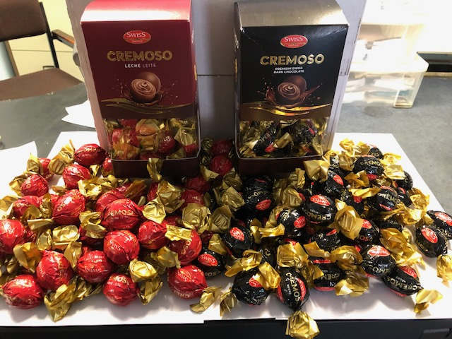
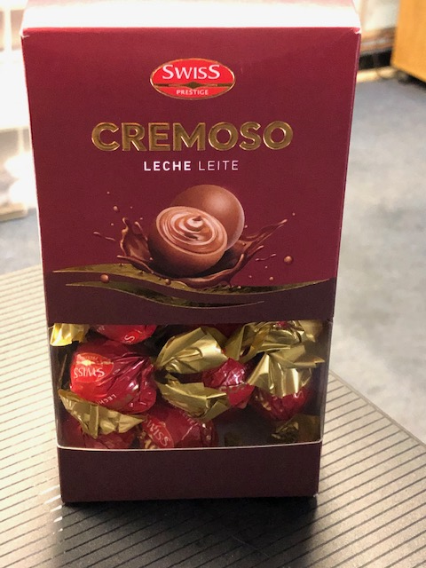
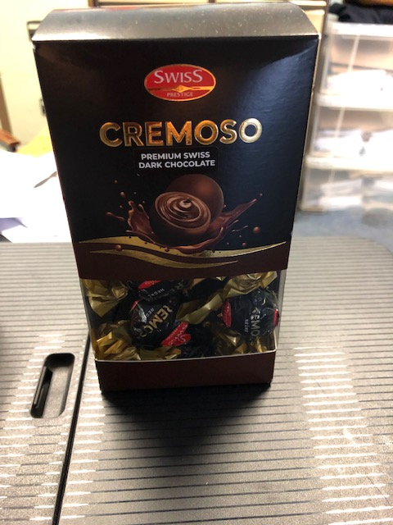
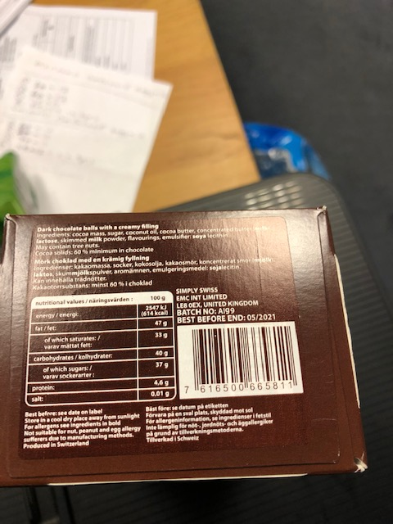
Swiss premium
300g truffle ball (One shot product same as Lindt only I am told it tastes better.
Premium extra fineMilk 16,000 units
Premium extra fineDark 18,000 units
Packed 10 to a carton 96 carton to a pallet
BBE May 21
Languages: UK, SE
RSP. 9.99 Euro

Slide 2
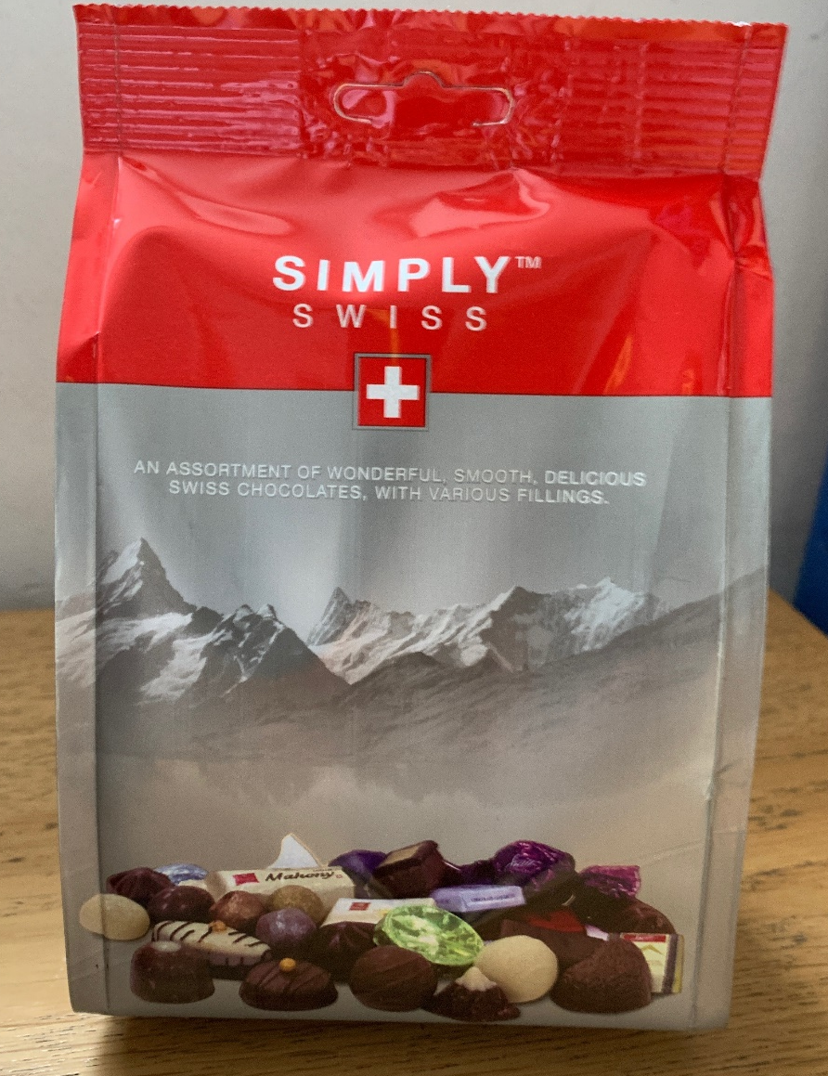
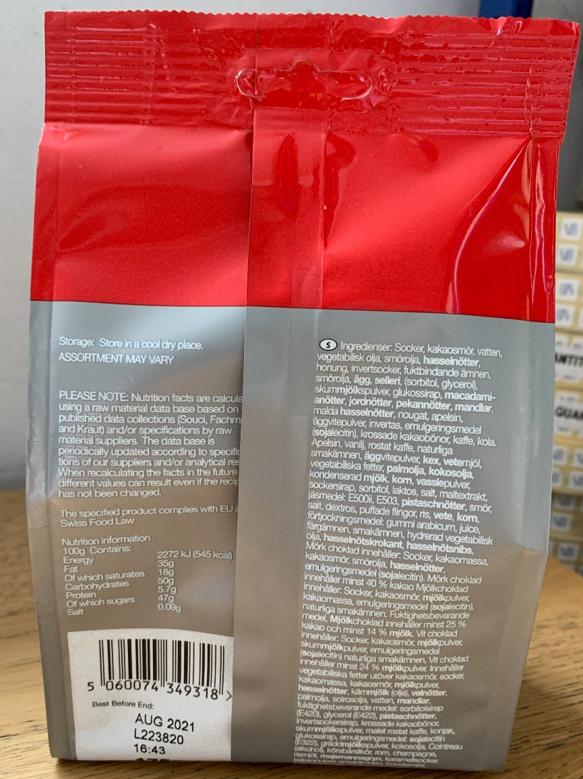
Simply Swiss 175g Assorted – Premium Chocolate
25 Units per Case
42 Cases per Pallet (UK)
1050 Units per pallet
50,000 Units available/2,000 Cases
BBE: Aug 2021
Language: SE, UK
RSP Euro 2.99/3.49

Slide 3
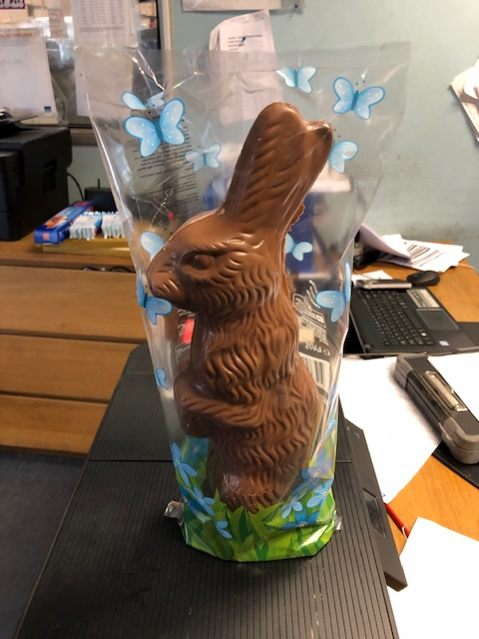
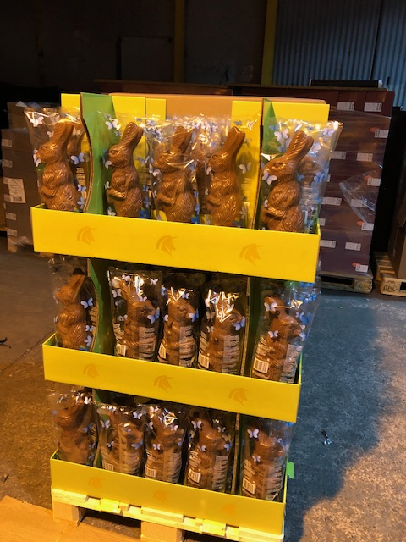
440g bunnies in full floor display
90 units in display
2 displays on a pallet
20 pallets available
BBE May/June 21
Lanuage: UK, DE, CH
RSP 14.00 Euro

Slide 4
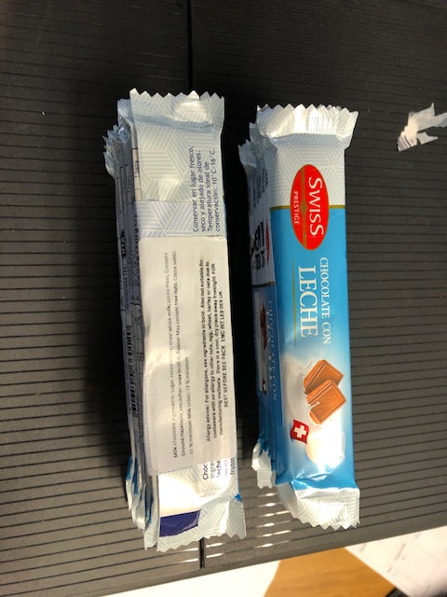
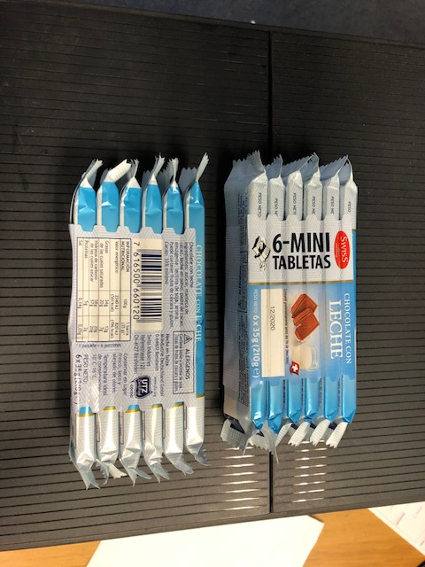
Extra fine Milk 35g x 6 bars (210g)
14 pallets/34,200 Units
Packed 12 packs to a carton 190 cartons on a pallet.
BBE: 12.20
RSP 7.95 Euro
Language: ES

