Slide 1

SPRING 2025 – AVAILABLE TO SELL

Slide 2

STYLE NUMBER | STYLE NAME
M01DD3 / K017A | PRNT KNIT JERSEY S/S BUTTON FRONT SHIRT
COLOR
GEOSTR - GEOMETRIC
COST | SIZING | UNITS | SMALL | MEDIUM | LARGE | XLARGE | XXLARGE
 | PREPACK | 1161 | 129 | 258 | 387 | 258 | 129
SIZE SCALE: S, M, L, XL, XXL
PRE-PACK: 1-2-3-2-1(9)

Slide 3
STYLE NUMBER | STYLE NAME
M44DD3K017 / A | PRNT KNIT JERSEY S/S BUTTON FRONT SHIRT
COLOR | COST | SIZING | UNITS | SMALL | MEDIUM | LARGE | XLARGE | XXLARGE
CNILEA - CHINOIS GRN LEAVES 3 |  | P-PACK | 408 | 68 | 136 | 102 | 102 | 0
GRKIMO - GRENADINE KIMONO |  | P-PACK | 432 | 72 | 144 | 108 | 108 | 0
STROMY - STORMY WEATHER JAPONICA |  | P-PACK | 600 | 100 | 200 | 150 | 150 | 0
TSDIAM - TAP SHOE DIAMONDE |  | P-PACK | 552 | 92 | 184 | 138 | 138 | 0
TSNPAL - TAP SHOE NEW PALMS |  | P-PACK | 432 | 72 | 144 | 108 | 108 | 0
IMAGES ON NEXT PAGE

Slide 4
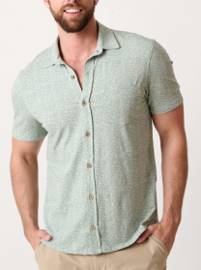
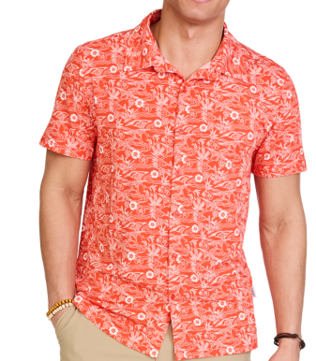


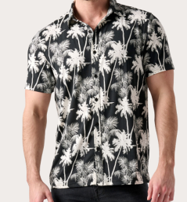
Chinois Green Leaves
Grenadine Kimono
Stormy Weather Japonica
Tap Shoe Diamonde
Tap Shoe New Palms

Slide 5

STYLE NUMBER | STYLE NAME
M44DD3K017 / A | PRNT KNIT JERSEY S/S BUTTON FRONT SHIRT
COLOR | COST | SIZING | UNITS | SMALL | MEDIUM | LARGE | XLARGE | XXLARGE
BBSTRA - BLACK BEAUTY STRAIGHT UP |  | P-PACK | 240 | 0 | 40 | 80 | 60 | 60
BCDIAM - BUNGEE CORD DIAMONDE |  | P-PACK | 480 | 0 | 80 | 160 | 120 | 120
BFDIAM - BLUE FOG DIAMONDE |  | P-PACK | 312 | 0 | 52 | 104 | 78 | 78
CMTROP - COCONUT MILK TROPISH |  | P-PACK | 540 | 0 | 90 | 180 | 135 | 135
CMTURK - COCONUT MILK TURK |  | P-PACK | 588 | 0 | 98 | 196 | 147 | 147

Slide 6


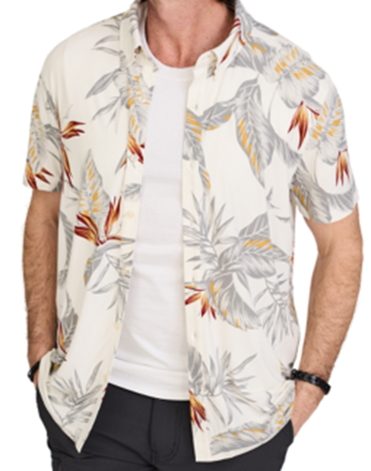
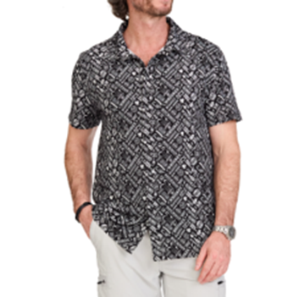


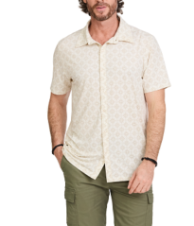
Bungee Cord Diamonde
Blue Fog Diamonde
Coconut Milk Turk

Slide 7
COLOR | COST | SIZING | UNITS | SMALL | MEDIUM | LARGE | XLARGE | XXLARGE
BBSTRA - BLACK BEAUTY STRAIGHT UP |  | P-PACK | 360 | 40 | 80 | 120 | 80 | 40
BLWAVE - BLUE FOG WAVES |  | P-PACK | 306 | 34 | 68 | 102 | 68 | 34
BWJOHN - BRIGHT WHITE JOHNNIE |  | P-PACK | 342 | 38 | 76 | 114 | 76 | 38
CBTROP - CHINA BLUE TROPISH |  | P-PACK | 189 | 21 | 42 | 63 | 42 | 21
CMTROP - COCONUT MILK TROPISH |  | P-PACK | 261 | 29 | 58 | 87 | 58 | 29
GEOSTR - GEOMETRIC STRIPE WHITE SAND |  | P-PACK | 234 | 26 | 52 | 78 | 52 | 26
SNOW2 - SNOW WHT AWNING STRIPE |  | P-PACK | 225 | 25 | 50 | 75 | 50 | 25
STROMY - STORMY WEATHER JAPONICA |  | P-PACK | 405 | 45 | 90 | 135 | 90 | 45
STYLE NUMBER | STYLE NAME
M48DD3K017 / A | PRNT KNIT JERSEY S/S BUTTON FRONT SHIRT
S-M-L-XL-XXL
1-2-3-2-1=9

Slide 8


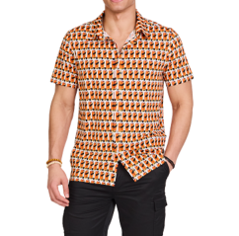

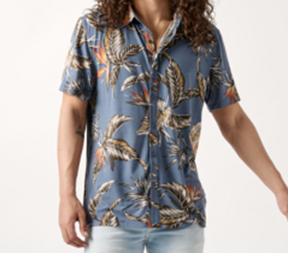

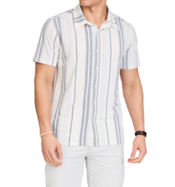
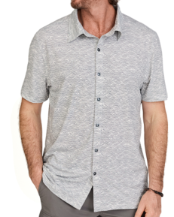
Blue Fog Waves
Bright White Johnnnie
China Blue Tropish
Coconut Milk Tropish
White Sand Geo
Snow White Awning
Stormy Weather Japonica

